Slide 1
CROP PRODUCTION
By Aniket Jamdade

Slide 2
Introduction
This dataset offers extensive information on crop production in India from 1997 to 2014, revealing key shifts and trends. The monsoon season consistently leads in production but shows a downward trend over time. The North region has stable production, while the East region has declined, and the West Zone and Union Territory have increased their production. Notably, Whole Year Season production has declined since 2003, whereas Winter and Monsoon Seasons have seen growth post-2003. The goal is to predict future crop production and identify key indicators and metrics that influence it, providing valuable insights for improving agricultural productivity in India.

Slide 3
About dataSet
1997
1998
2014
84 Billion
in Crop
Production
Sudden Decrease in Production to 54 Billion
Constant Trend Production of Crop

Slide 4
Contents
Home Page: An overview of the dataset’s main focus on states, regions, crops, and seasons.
District Page: Drill down to the district level to explore crop production and area of cultivation.
Coconut: A dedicated dashboard focusing on coconut, as it covers most of the dataset.
Time Series: Analyze year-to-year data, explaining region, season, and crop yield trends.
Production: Examine how production growth has influenced individual crop production.

Slide 5
Home page
Top 3 crops as per Production in India
Sugarcane
Rice
Wheat
The total production of Sugarcane is the Highest Among All Crops
Utter Pradesh has the Highest Production and Cultivation area among all-state
Maximum Production of Sugarcane Comes When It Sown in Whole Year
The total production of Rice is the Second Highest Among All Crops
West Bengal has the Highest Production, but the Cultivation area is highest in Uttar Pradesh
Maximum Production of Rice Comes When It Sown in Monsoon Season
The total production of Wheat is the Third Highest Among All Crops
Utter Pradesh has the Highest Production and Cultivation area among all-state
Maximum Production of Wheat Comes When It Sown in Winter Season
North India Is Having Maximum Production Among All Zones

Slide 6
District page
The top 3 Districts in production and cultivation area belong to Utter Pradesh
In Every state some Districts are Dominating in Production and cultivation areas like
In West Bengal – Murshidabad, Midnapur West, and Hooghly Are Dominating
In Utter Pradesh – MuzzferNagar, Kheri, Bijnor
If the variety of crops is higher in the state IT Doesn’t mean maximum production will come from the same state.
Karnataka has the highest Number of Crops but the maximum production comes from another state
The lowest variety of crops belongs to Chandigarh
59 different types of crops are cultivated in 646 districts of India

Slide 7
Coconut page
Since coconut dominates this dataset, we decided it needs its dedicated dashboard.
Kerala leads this market with a total production of 100 billion coconuts. Consequently, the southern region has the highest production.
It's remarkable that only 28 million total area is required to produce 100 billion coconuts.
The production value is influenced by the season it's grown in. Since coconut production occurs year-round, it is not restricted by seasons.
In 2011, a spike in production was observed, which increased the demand for coconut across the country.

Slide 8
Time Series page
We can see that production by season is led by the monsoon season since most farmers invest their time in this season, allowing for more crops to grow. Monsoon season has the highest production but shows a downward trend over time, whereas other seasons have lower and relatively stable production levels.
Crop yield is on an upward trend, indicating increased interest in farming and buying land. Overall crop yield shows a slight upward trend, reflecting improvements in productivity over the years.
The North region has been consistent in farming, maintaining a production rate of 2 billion from 1997 to 2014. The East region shows Improved production initially but trends downward, while other regions have lower and more stable production levels.

Slide 9
Production Page
The maximum growth in production occurred between the years 2007 and 2008, marking a significant upward surge. Conversely, the steepest decline in growth was observed between 1997 and 1998.
In terms of regional production, the North Zone experienced a decrease, while the West Zone and Union Territory saw an increase in production levels.
Seasonally, production in the Whole Year Season declined continuously after 2003. However, there was an encouraging increase in production during the Winter and Monsoon Seasons after 2003.
Sugarcane seems like the hack to maximum production no wonder people can’t live without sugar.

Slide 10
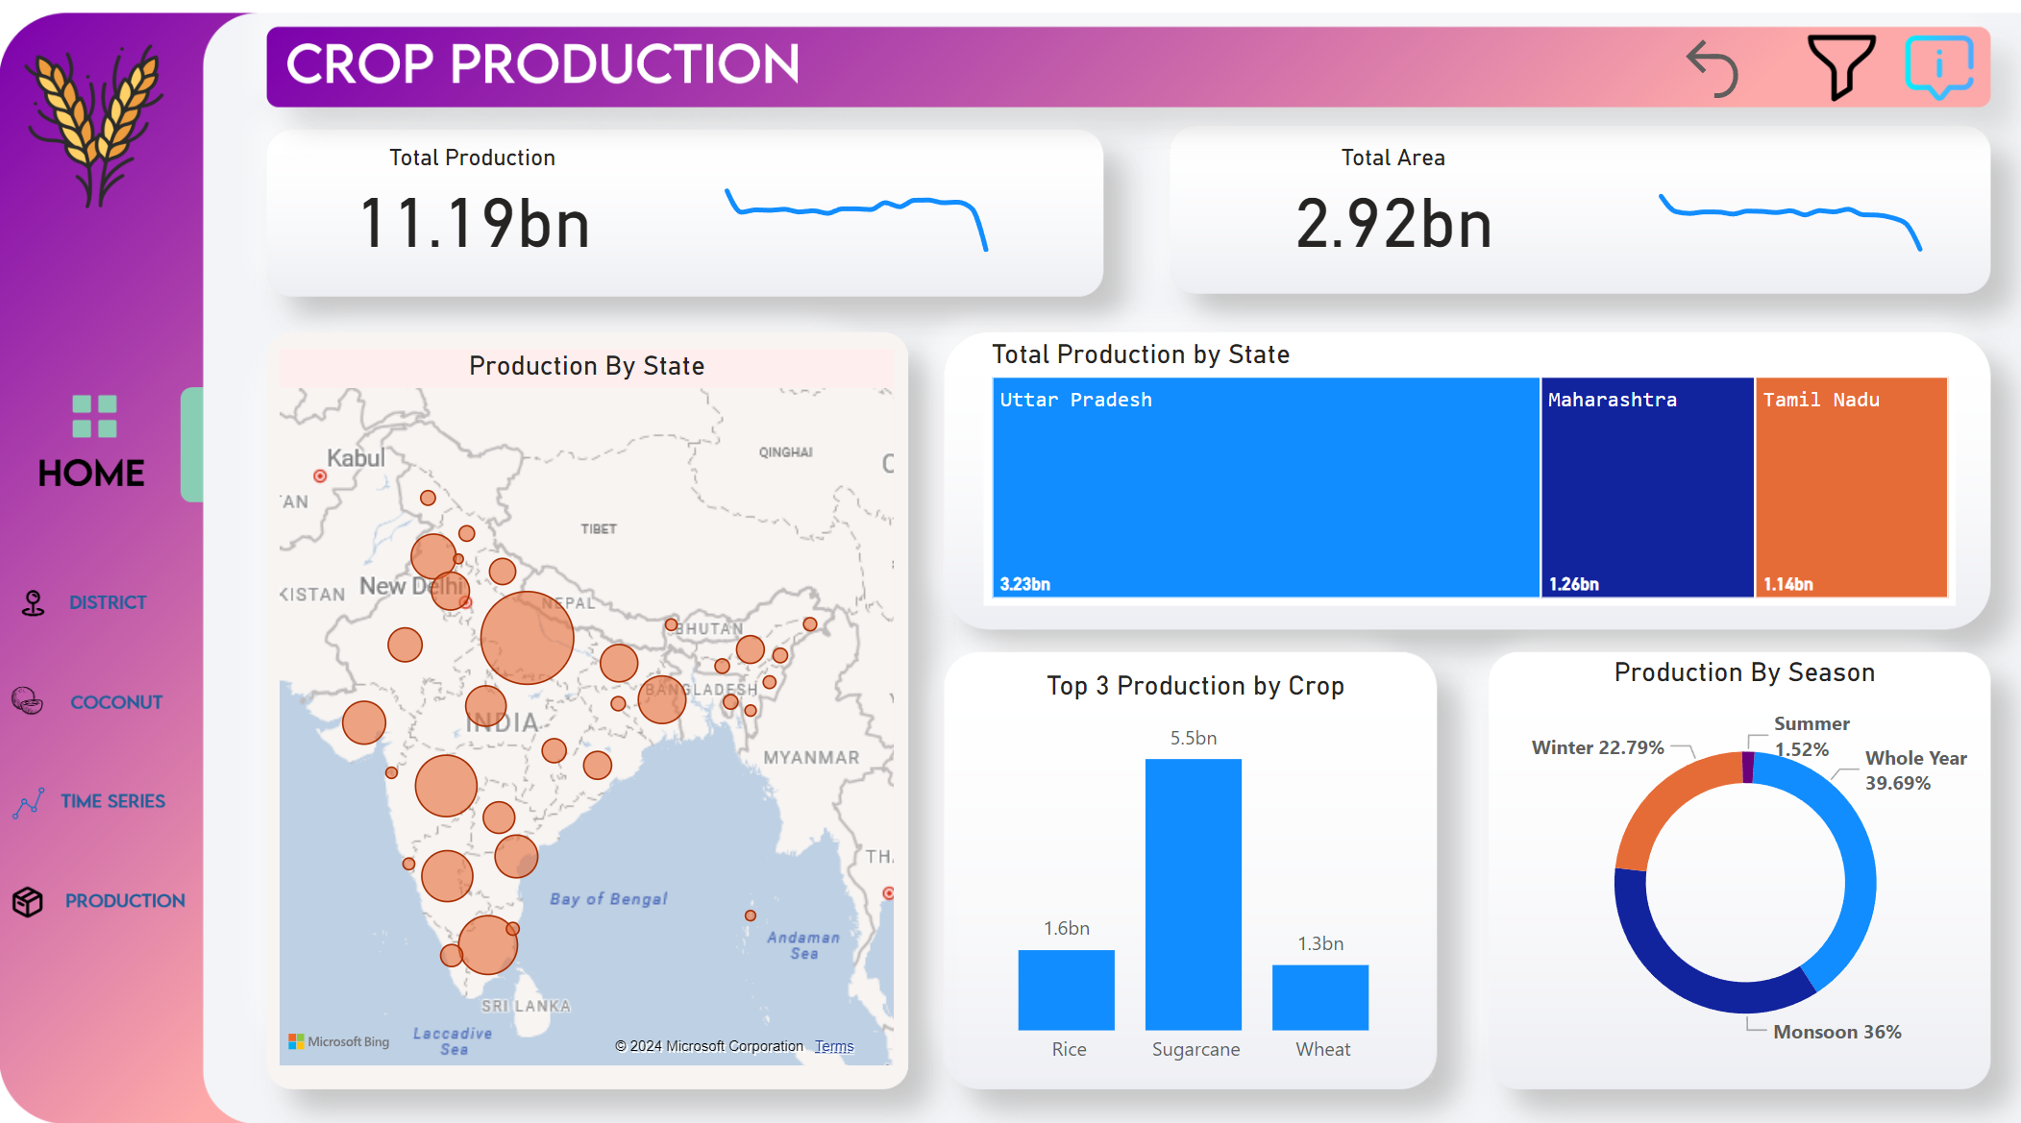
My design
Link to Report

Slide 11
Thank you

